Slide 1
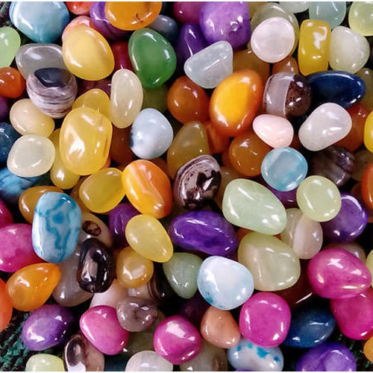
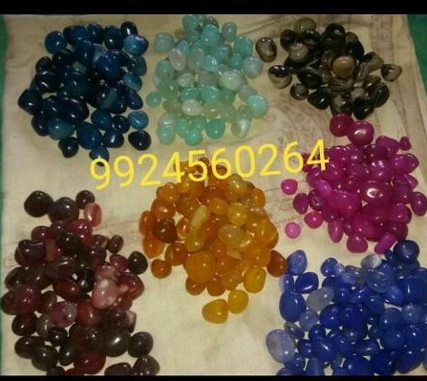
Separation of Substances
Chapter 5

Slide 2
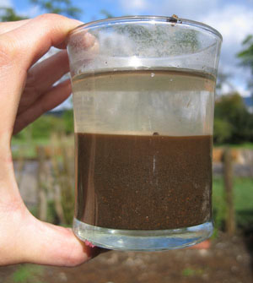
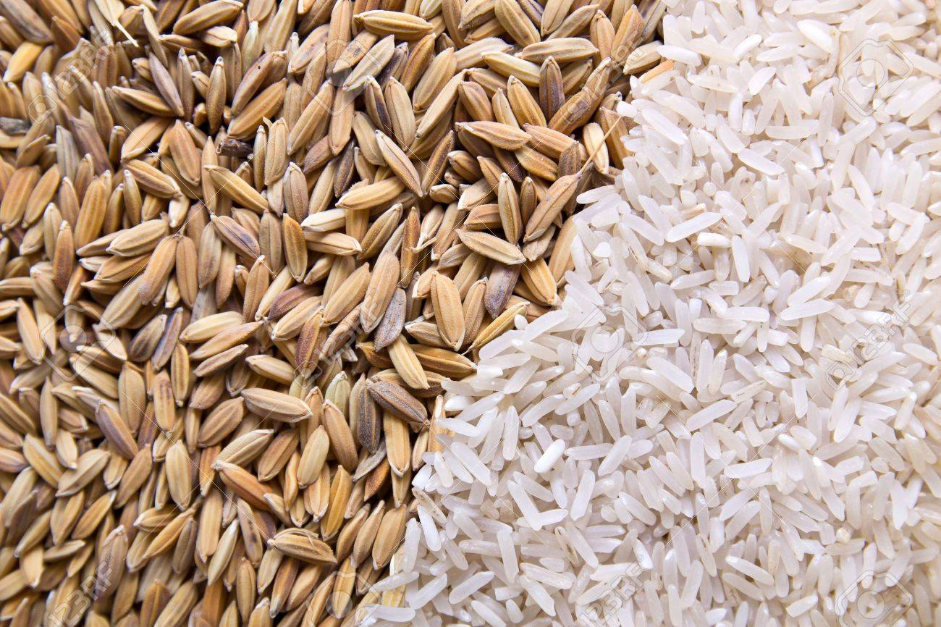
Ganesh was given 3 thing and his mother asked him to collect or separate the things
First jar contains a mixture of gem stones
Second glass tumbler contains water mixed with the sand
Third the rice with the husk
Can Ganesh use the same technique to separate the gems, water and rice from the mixture

Slide 3
Mixture and Pure substance
MIXTURE: When a substance contains two or more substance is called the MIXTURE
Example sugar water, atmosphere, milk, etc
PURE SUBSTANCE : When a substance contains only Single ATOM or MOLECULE is called the PURE SUBSTANCE
Example: sugar crystals, salt crystal, chemical in laboratory,etc

Slide 4
TYPES OF MIXTURE AND ITS PROPERTIES
The constituents (substance) may be of any ratio
They retain their individual property as they do not mix with each other
The constituent can be separated by simple methods
( in water to identify the purity check the boiling and melting point. Eg: boiling point of pure water – 100 degree Celsius i pure water the boiling point will be less than 100)
S

Slide 5
Why Separation is necessary?
1) To remove undesirable substance: small stones in rice may harm our body and teeth
Some harmful substance in water may harm our body when consumed
Respirator is a machine which filters the oxygen from the air and supply to the patient with respiratory problem
2) To obtain useful substance: Butter can be separated from curd
Petrol can be separated from crude oil
3) To obtain pure substance: We may need some pure chemical for laboratory and to our home

Slide 6
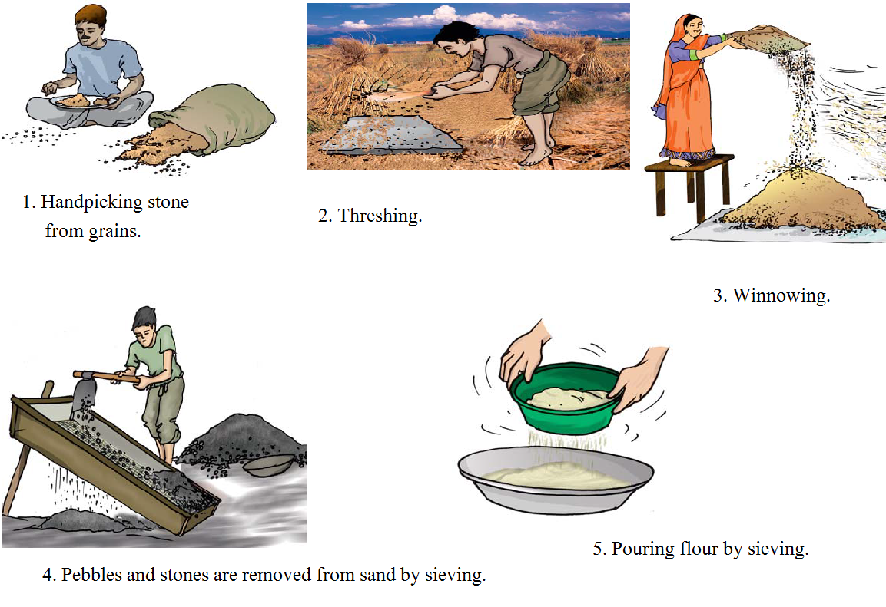
METHOD OF SEPARATION SOLID FROM OTHER SOLID
By colour, shape, Weight, attraction by magnet, etc

Slide 7
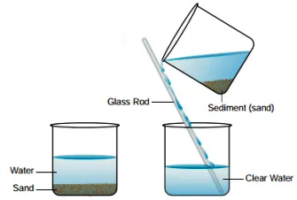
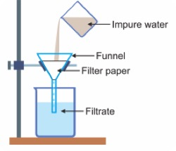
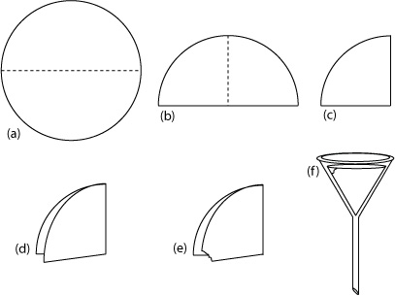
SEPARATION OF INSOLUBLE SOLID FROM LIQUIDS
Sedimentation and decantation: water and sand
Filtration: tea duct from tea, impurities from drinking water
Loading: Clay take long time to settle in water so ALUM (aluminium sulphate)is used to increase the speed of settlement.

Slide 8
Method of separation for obtaining DRINKING WATER
https://youtu.be/c40yPpQG8e0

Slide 9
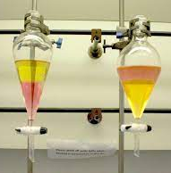
Distillation
Distillation is a method of obtaining pure liquid from a solution
Two separate miscible liquids fractional distillation method is used To separate the immiscible liquids a separating funnel is used
https://drive.google.com/file/d/1pmIP_6HNbHir7FUA6AgGq9p-QWhd5fTc/view?usp=drivesdk

Slide 10
Solubility (record from chapter 4)
When you mix sugar in water, sugar breaks up into individual molecules in the water, the sugar seems to disappear in the water. The sugar and water together formed a solution of sugar in water. The water here is called a solvent. The sugar is called the solute A solvent and solute together forms a solution Water can dissolve a large number of substance in it so it’s called as a universal solvent.
The substance which dissolve in water can be easily got back by using the methods such as evaporation, condensation etc
The solubility of sugar increases as the temperature increases But the solubility of salt increases very little with temperature
The solubility of gas in water decreases with increase in temperature

Slide 11
Importance of water as a solvent
Large number of substances dissolved in water A body cannot absorb food substance unless they are dissolved in water The process of digestion requires water Several waste materials produced in a body dissolve in water and excreted out Plants can absorb nutrients from the soil only with the help of water Gases such as oxygen and carbon dioxide which are dissolved in water are important for survival of aquatic life

Slide 12
Recap
What are pure substances? What is loading Differentiate sedimentation and decantation What is Lee Biggs contains Importance of water
method of separating solid from solid

